Slide 1
Galileo and the Scientific Method
Day 2

Slide 2
Pair-Share
If a scientist has a theory or model she wants to prove, how does she go about doing that?
Notes:
Most will bring up an experiment
Possible emphasis - according to William Wallace, Galileo’s chief influence upon the development of science is not the use of experiment, but the belief that “ the book of nature is written in mathematical language”

Slide 3
Is certain knowledge possible?
Realism
Theories can tell us about reality (with varying degrees of certainty, absolute certainty is rarely reached)
Instrumentalism
Theories can make useful or unuseful predictions, but they can never tell us about reality

Slide 4
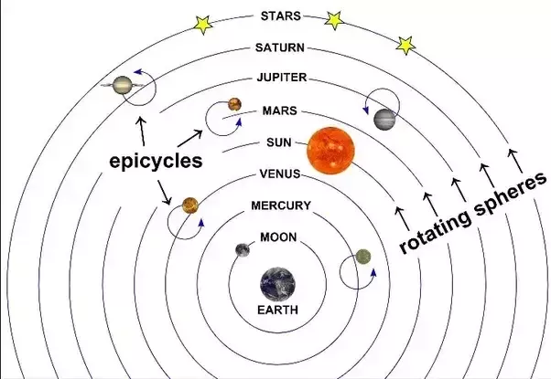
Ptolemaic Model
Instrumentalism - were there really epicycles and eccentrics in nature, or were these just there to “save the phenomenon” until a better explanation could be found?

Slide 5
Hypothetico-Deductive Method - “If… then…”
If it’s raining, then the ground is wet
It is raining
Therefore the ground is wet
If it’s raining, then the ground is wet
The ground is wet
Therefore it is raining

Slide 6
Hypothetico-Deductive Method - “If… then…”
If it’s raining, then the ground is wet
It is raining
Therefore the ground is wet
Science is more like this argument, because the hypothesis (if…) is typically not observable
Certainty increases as we rule out alternative explanations
If it’s raining, then the ground is wet
The ground is wet
Therefore it is probably raining

Slide 7
Scientific Explanations - Example 1
If the heart pumps the blood and the blood circulates throughout the body, then the blood leaving the heart should equal the blood leaving the heart, there should be a mechanism to help blood return to the heart, and the blood in the arteries should connect to the blood in the veins
The blood leaving = the blood returning
There is a mechanism (valves)
The vessels connect through capillaries
Therefore, the heart pumps blood and the blood circulates throughout the body
Presented by William Harvey in 1628, confirmed by Malpighi in 1660

Slide 8
Scientific Explanations - Example 2
If there is a planet beyond Uranus, then its gravitational force is what causes discrepancies in Uranus’ observed position
There are discrepancies in Uranus’ observed position
There is a planet beyond Uranus
Predicted by Urbain Le Verrier and John Couch Adams in the 1840’s
The planet (Neptune) was directly observed by Johann Galle in 1846

Slide 9
Three More Data Points
Galileo and some of his competitors thought there were several pieces of evidence that could determine the truth or falsity of Copernicanism.
Understand these phenomena and prepare to explain how they relate to the Copernican theory in an “if-then” statement.

Slide 10
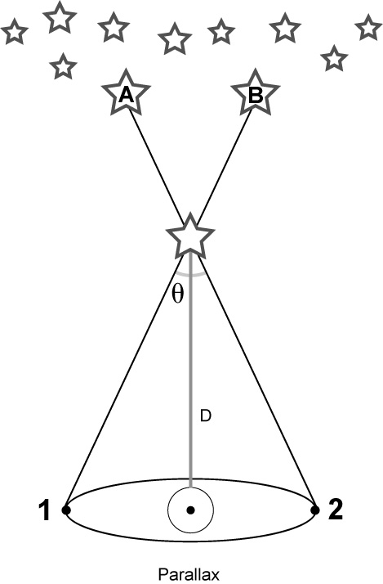
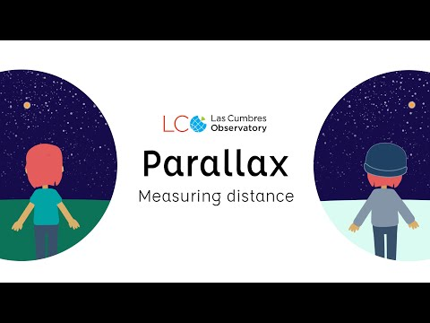
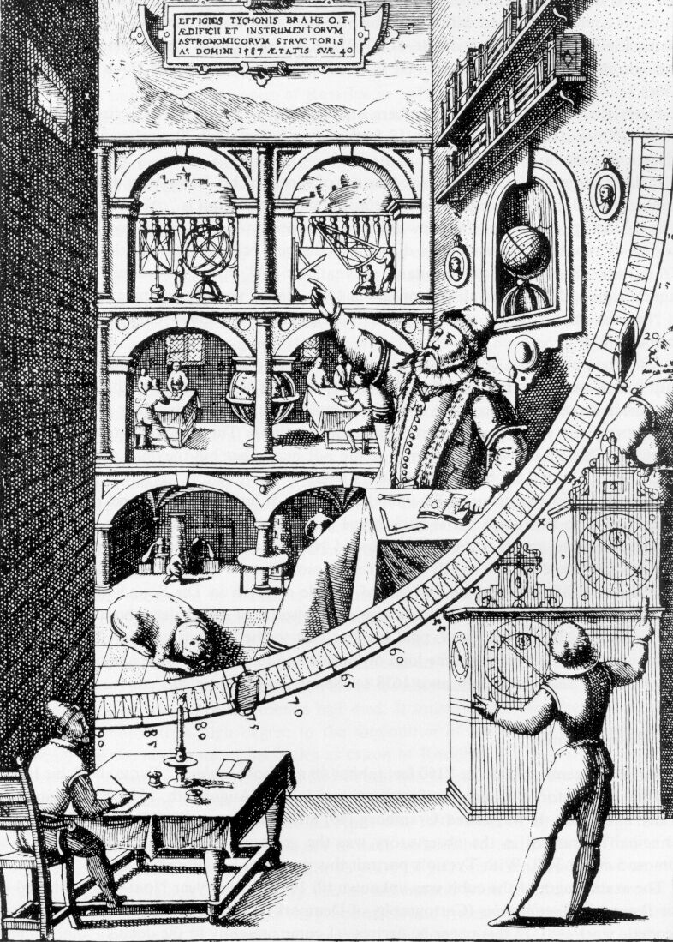
Tyco Brahe - Parallax
Most accurate stellar observations to date
Notes:
http://homework.uoregon.edu/pub/emj/121/lectures/tycho121.html

Slide 11
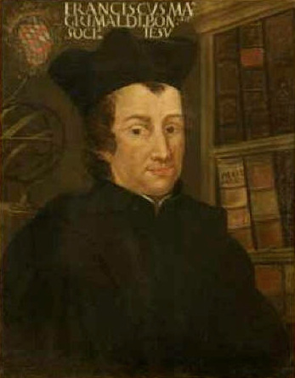
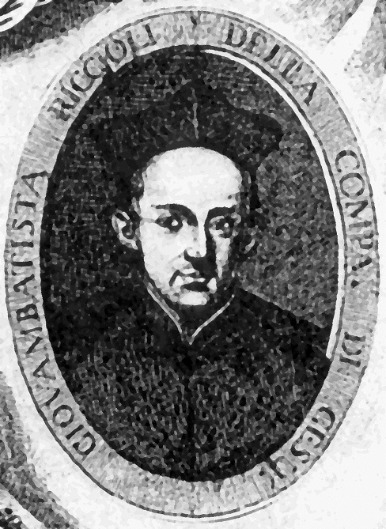
Francesco Maria Grimaldi and Giovanni Battista Riccioli
Coriolis
Riccioli’s New Almagest (1651)
126 arguments concerning Earth's motion—
49 - yes
77 - no
1 of the 77 - Coriolis

Slide 12
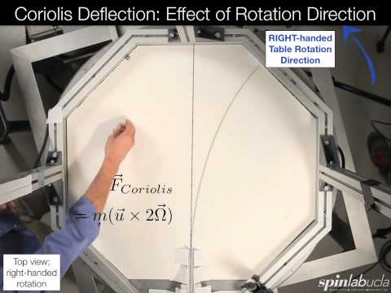
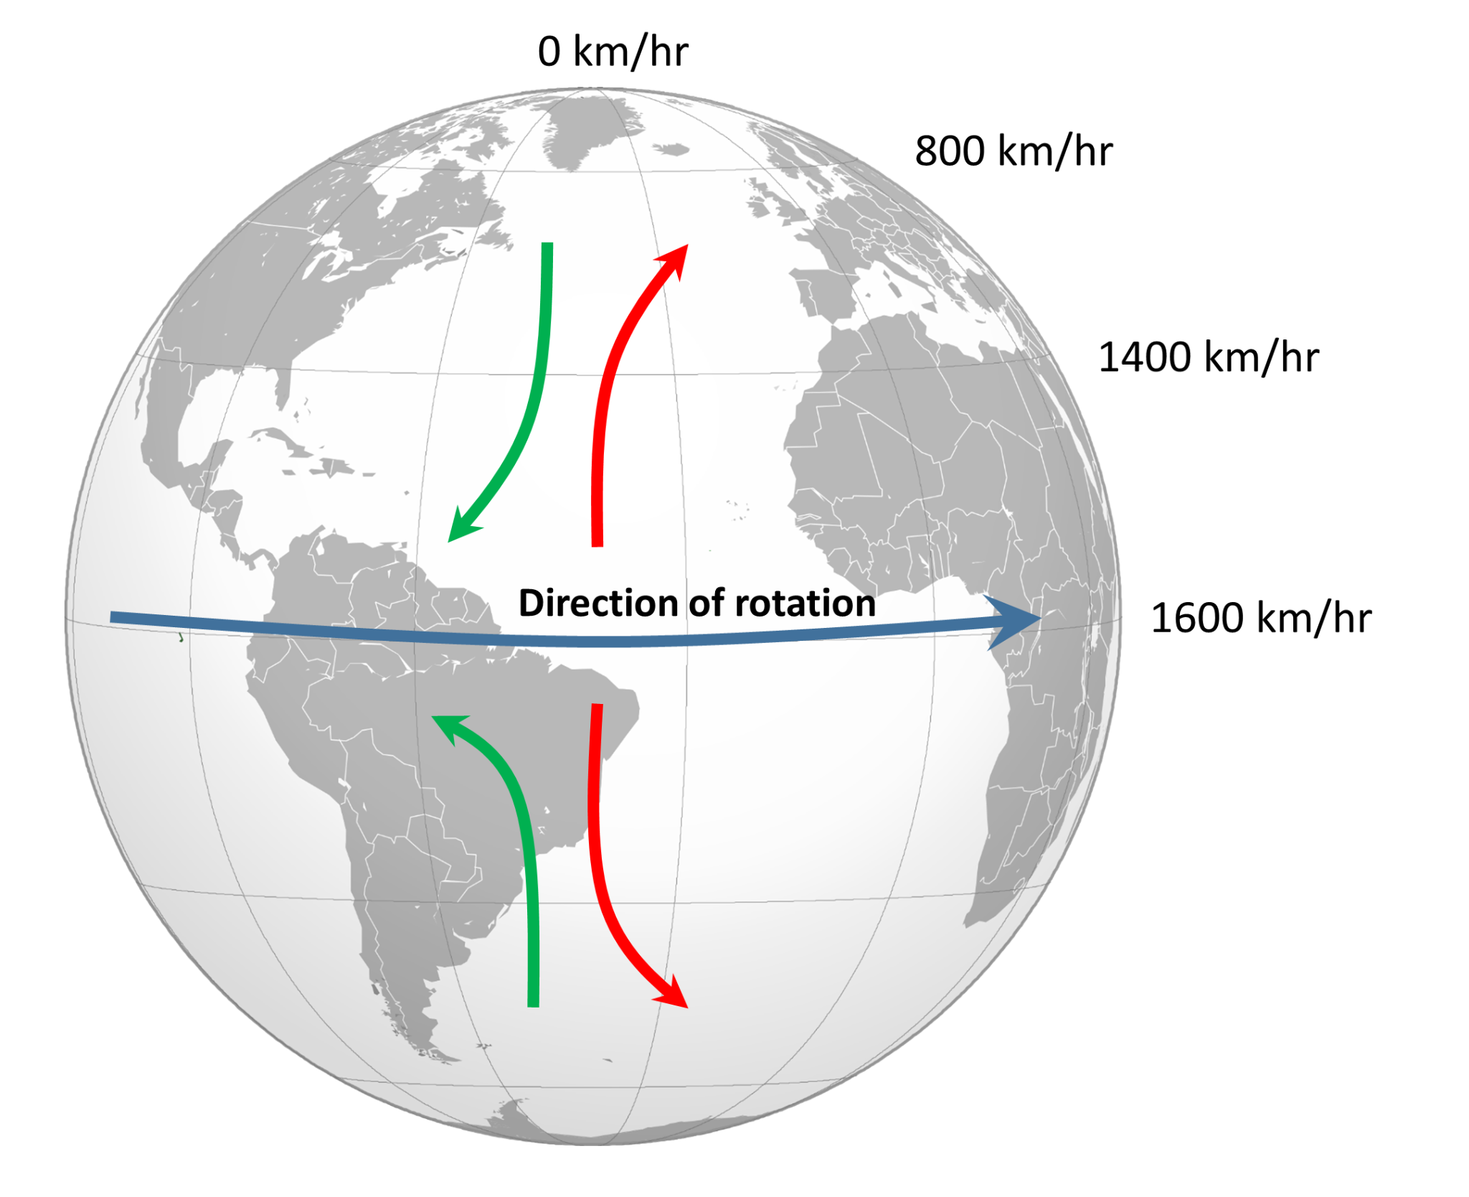
Coriolis Effect
Properties of bodies moving across the face of a rotating sphere

Slide 13
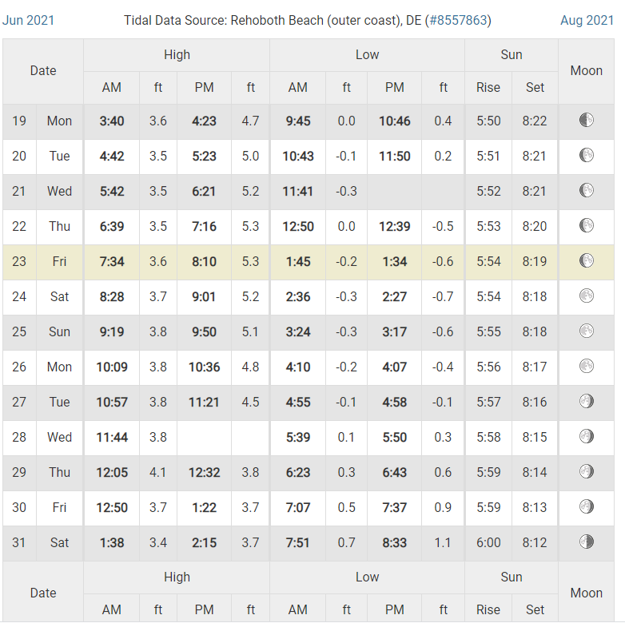
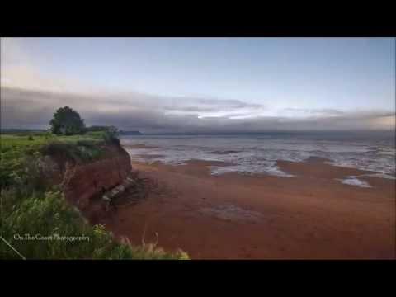
Galileo - Tides

Slide 14
Homework

